Slide 1

EcoLogix AI

Slide 2


Background
Identity: EcoLogix AI leverages advanced predictive analytics to minimize e-commerce logistics carbon emissions.
Data Source: Sourced from Kaggle (Green Logistics: Carbon Footprint for E-commerce), containing 12,000 transaction records
Traffic Data: Metro Interstate Traffic Volume & Urban Traffic Density (converted to daily congestion averages).
Weather Data: Daily Weather Dataset (integrated temperature, humidity, wind speed, and precipitation).
Emission Data: CO2 Emission by Vehicles (merged engine specs and standardized vehicle class coefficients).
Imputation: Applied mean imputation for numerical gaps and mode imputation for categorical attributes.
Encoding & Scaling: Handled categorical fields via Label/One-Hot encoding and standardized numerical features
Feature Engineering: Created complex interaction terms (distance-to-weight ratio and traffic-distance interactions).
Core Inputs: Integrates vehicle types, distance, package weight, weather metrics, and traffic volume.
The Problem: The logistics industry is a primary driver of global emissions, yet traditional routing model priorities are limited to speed and operational cost.
Project Evolution: Began with baseline linear regression testing basic distance impacts. Advanced into a multi-source architecture merging climate, traffic, and vehicle data layers.

Slide 3
Objectives
Project Objectives
Minimize Footprint
Fleet Transformation
Infrastructure Strategy
SDG Alignment
Machine Learning Aims
Accurate Prediction: Build high-explanatory models (achieving a baseline Multiple Linear Regression $R^2 = 0.9087$) to accurately forecast delivery carbon footprints ($kgCO_2e$) using historical data.
Early Warning System: Deploy a Decision Tree Classifier (achieving $92.4\%$ accuracy) to automatically flag and categorize high-emission routes before execution.
Mitigate Multicollinearity: Engineer a highly stable Ridge Regression architecture to smoothly handle complex, multi-source data parameters without overfitting.
Isolate Variance: Extract feature importance metrics to mathematically isolate how traffic volume and climate stress modify baseline emissions.

Slide 4
SDG Relation
SDG 13 (Climate Action): Minimizes the logistical carbon footprint ($kgCO_2e$) by replacing traditional, cost-only routing with predictive AI analytics.
SDG 9 (Industry, Innovation & Infrastructure): Integrates complex multi-source data architectures (traffic, weather, and fleet specs) to deploy automated green routing frameworks.
SDG 11 (Sustainable Cities & Communities): Focuses on "Urban Last Mile" data to reduce city traffic congestion, idle fuel waste, and localized air pollution.
Managerial Impact: Provides the mathematical backing needed to justify corporate investments in green fleet procurement and micro-fulfillment centers.

Slide 5
Data
Data Source
Primary Source: Sourced from Kaggle (Green Logistics: Carbon Footprint for E-commerce).
Volume: Comprises 12,000 transaction rows of core e-commerce delivery logs.
Preprocessing & Multi-Source Integration
Data Integration: Expanded the core dataset by left-joining external traffic congestion layers, climatic friction data, and engine emission baselines.
Missing Value Handling: Handled missing integration values using mean imputation for numerical variables and mode imputation for categorical attributes.
Feature Transformation: Applied Label Encoding to categorical variables (like Vehicle_Type) and standardized numerical elements using StandardScaler.
Feature Engineering: Developed advanced operational density interaction terms including distance-to-weight and traffic-distance parameters.
​

Slide 6
Model Selection and Training/Testing
Model Training Details
Data Split: The dataset was partitioned into an 80% training set and a 20% test set.
Encoding: Categorical variables like Vehicle_Type were transformed using Label Encoding.
Scaling: Numerical features were standardized using StandardScaler to optimize model convergence.
Advanced Setup: A mathematically stable Ridge Regression model was built to handle a matrix of over 12,000 engineered column variables and eliminate multicollinearity.
Suggested Slide Visualizations
Actual vs. Predicted Plot: A scatter plot demonstrating the strong positive linear relationship between delivery distance and emissions.
Error Distribution Histogram: A residual plot showing the distribution of prediction errors concentrated near zero.
Feature Importance Bar Chart: A visual ranking proving that distance and vehicle type dictate the baseline, while traffic and weather modify variance.

Slide 7
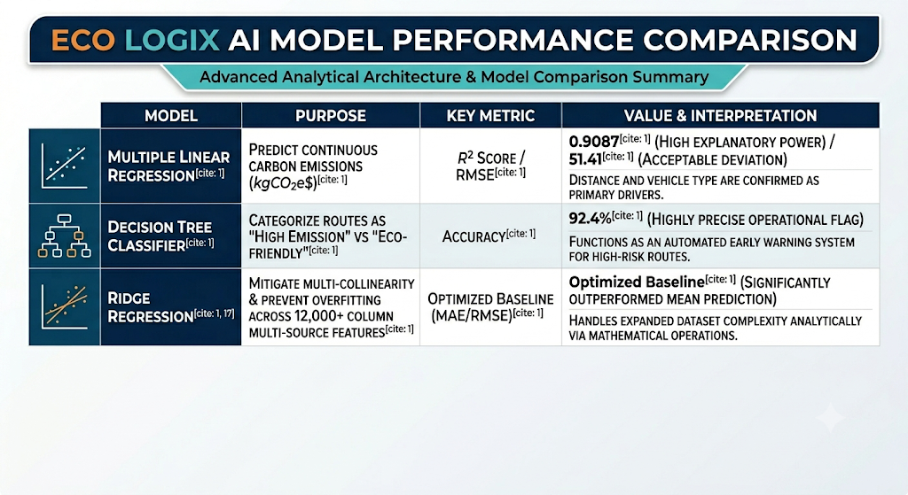

Slide 8
Evaluation Results
1. Key Analytical Findings
Strong Correlations: Delivery distance shares a dominant 0.95 correlation with emissions; package weight holds a strong 0.79 correlation.
Emission Outliers: Most operations have a low footprint, but heavy truck usage drives extreme spikes up to 1,280 kgCO2e.
Fleet Neutralization: Transitioning to electric vans (EVs) and drones effectively drops emission profiles to near-zero levels.
Traffic & Climate Friction: Feature importance proves severe congestion and extreme weather geometrically inflate emission rates.
2. Strategic Decisions
Fleet Transformation: Quantified data provides the financial and corporate justification for green fleet procurement.
Decentralized Hubs: High stop-and-go urban friction demands the implementation of localized micro-fulfillment centers.
Lightweight Packaging: High carbon penalties on bulky items validate the urgency for lightweight packaging initiatives.
AI Routing Software: Real-time, AI-driven routing is essential to mitigate operational costs from gridlock and environmental stress.

Slide 9
Deployment
Automated Early Warning System: Successfully deployed the Decision Tree Classifier as an operational gatekeeper to automatically flag high-risk, high-emission routes before execution.
Fleet Transformations: Provided the empirical, data-driven framework required to transition logistics procurement toward electric vans (EVs) and drones, effectively neutralizing route emission profiles.
Decentralized Node Strategy: Mathematically validated the implementation of localized micro-fulfillment hubs to bypass severe stop-and-go urban traffic bottlenecks.
Real-Time Dynamic Routing: Established the quantitative framework for integrating AI-driven routing software to systematically eliminate the hidden fuel costs of traffic and climatic friction

Slide 10
Thank you!

